Slide 1
FACE RECOGNITION USING MACHINE LEARING

Slide 2
NAME : B.SANTHIYA EMAIL ID : bsanthiya863@gmail.com NM ID : 74D179A6EA17C8FA71F41278DA881C73 COLLEGE : PARK COLLEGE OF ENGINEERING AND TECHNOLOGY DEPARTMENT: COMPUTER SCIENCE AND ENGINEERING REG NO :712221104018

Slide 3
AGENDA
1. Problem Statement
2.Project Overview
3. End Users
4.Our Solution and Proposition
5. Key Features
6.Modelling Approach
7. Results
8. Conclusion

Slide 4
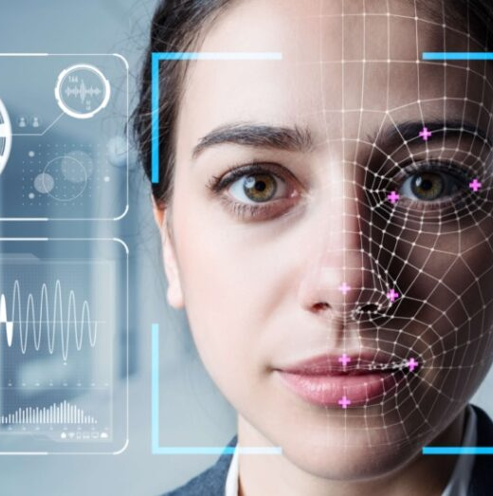
PROBLRM STATEMENT:
Develop a robust face recognition system capable of accurately identifying individuals from images or video footage in real-time. The system should address challenges such as variations in lighting conditions, facial expressions, occlusions, and pose changes to achieve high accuracy and reliability across diverse scenarios.

Slide 5
PROJECT OVERVIEW
Frontal Face Detection: Utilize a frontal face algorithm to detect and locate frontal faces within the video stream or image frames.
Feature Extraction: Extract distinctive features from detected frontal faces, such as key facial landmarks or embeddings, using deep learning techniques.
Face Matching: Compare the extracted features against a database of known faces to identify individuals.
Real-time Processing: Implement efficient algorithms and optimizations to ensure real-time face recognition with minimal delay.
User Interface: Develop a user-friendly interface to visualize face recognition results and provide feedback to users.
Integration: Integrate the face recognition system with existing security systems, surveillance cameras, or access control mechanisms.

Slide 6
END USER
Security Companies: Security companies could use your face recognition system for access control in buildings, monitoring public spaces for security threats, or identifying individuals in surveillance footage.
Government Agencies: Government agencies may use your system for border control, law enforcement, or tracking individuals of interest.
Retailers: Retailers could utilize the face recognition system for customer analytics, personalized marketing, or identifying known shoplifters.
Corporate Offices: Corporate offices might use the system for access control to secure sensitive areas or for attendance tracking.

Slide 7
OUR SOLUTION AND PROPOSITION
Solution: Real-time Face Recognition System
Our solution is a real-time face recognition system with advanced algorithms for accurate detection, feature extraction, and matching of faces. Key components include:
Advanced Face Detection: Utilizes cutting-edge frontal face detection algorithms for accurate identification of faces facing towards the camera.
Feature Extraction: Employs deep learning techniques to extract distinctive features for robust recognition in various conditions.
Face Matching: Utilizes sophisticated algorithms for rapid and accurate matching against a database of known faces.
Real-time Processing: Ensures seamless integration with minimal delay for instant recognition in live video streams.
Intuitive User Interface: Provides a user-friendly interface for clear visualization and easy interaction.

Slide 8
OUR SOLUTION AND PROPOSITION
Proposition:
Our face recognition system offers:
Enhanced Security: Strengthened security measures through accurate identification for access control and surveillance.
Efficient Operations: Streamlined tasks such as attendance tracking and customer identification for increased efficiency.
Personalized Experiences: Enables personalized marketing and tailored services based on individual recognition.
Research and Development: Facilitates innovation and experimentation in face recognition technology for researchers and developers.
Compliance and Privacy: Ensures compliance with data protection regulations and privacy safeguards for ethical use.

Slide 9
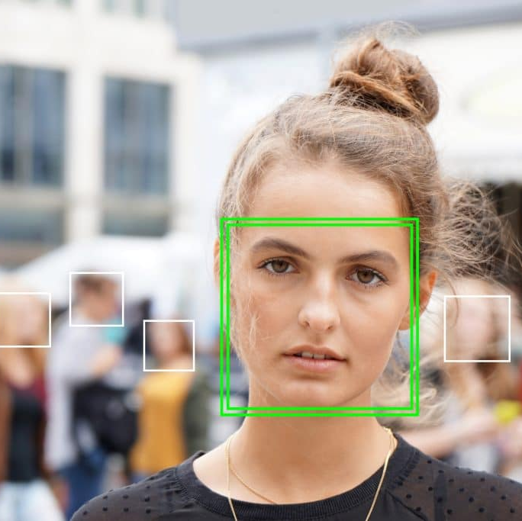
KEY FEATURES
High Accuracy: Our system achieves high accuracy in identifying individuals, even in challenging conditions such as varying lighting, angles, and occlusions. This ensures reliable performance in real-world scenarios.
Real-time Processing: Utilizing efficient algorithms and optimizations, our system performs face recognition in real-time with minimal delay. This enables instantaneous identification of faces from live video streams or camera feeds.
Scalability: Our system is designed to handle a large number of faces and can scale to accommodate growing datasets and user bases. This makes it suitable for deployment in environments with high throughput and traffic.
Robustness: We have implemented measures to enhance the robustness of our system against factors such as changes in appearance (e.g., facial hair, glasses), age progression, and environmental variations. This ensures consistent performance across diverse conditions.

Slide 10
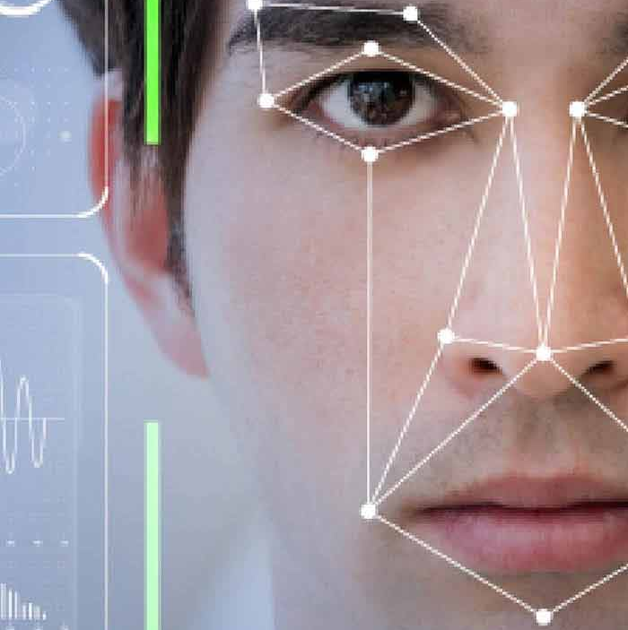
MODELING APPROACH
Modelling approach we employed to develop our face recognition system. This will include details on the algorithms, techniques, and methodologies used for tasks such as face detection, feature extraction, face matching, and real-time processing. We'll provide insights into the architecture of our models and how they were trained and optimized for optimal performance.

Slide 11
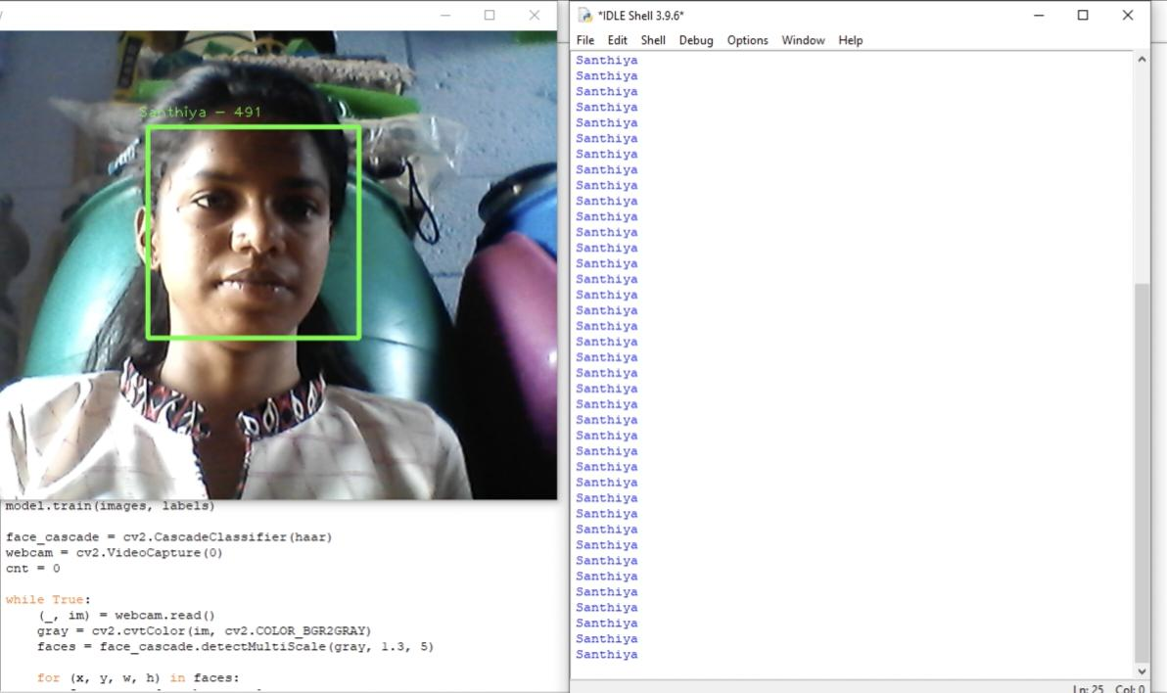
RESULTS

Slide 12
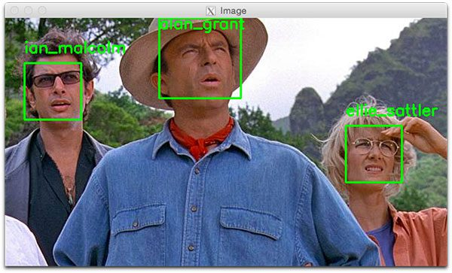
CONCLUSION
Finally, we'll conclude the document by summarizing the key findings and contributions of our face recognition project. We'll reiterate the significance of our solution, its implications for various industries and applications, and potential avenues for future research and development. Additionally, we'll highlight any key takeaways or lessons learned from the project and express our vision for the continued advancement of face recognition technology.

Slide 13
Thank you

